Slide 1
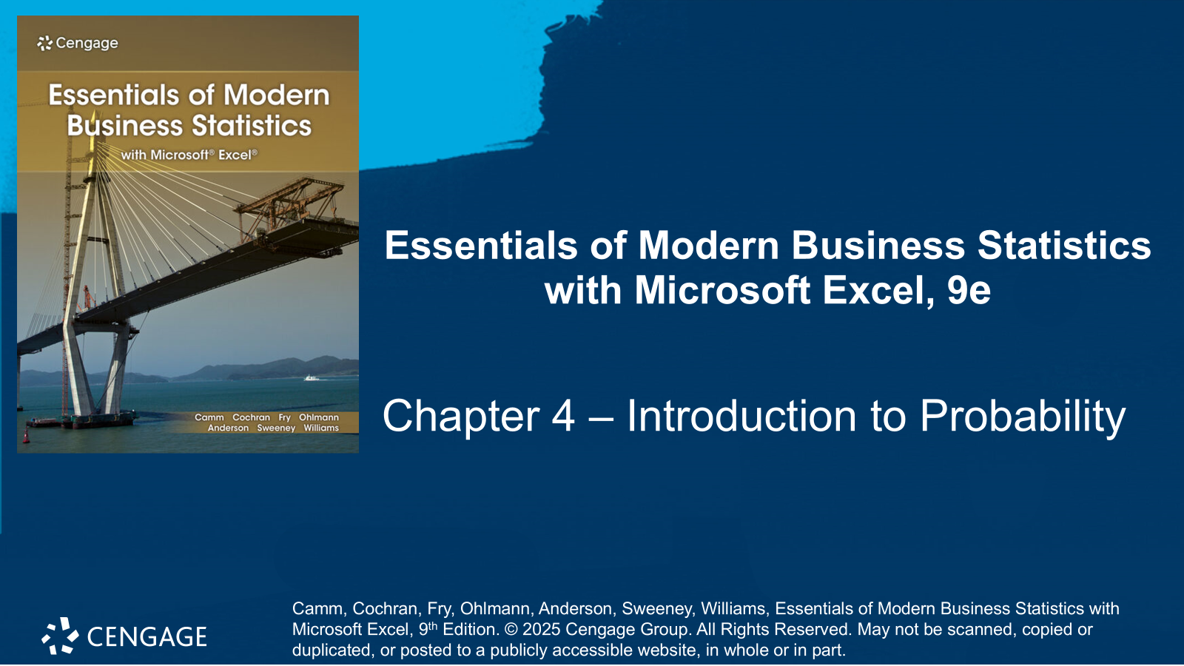

Slide 2
Chapter Contents
4.1 Experiments, Counting Rules, and Assigning Probabilities
4.2 Events and Their Probability
4.3 Some Basic Relationships of Probability
4.4 Conditional Probability
4.5 Bayes’ Theorem
Summary

Slide 3
Chapter Objectives
After completing this chapter, you will be able to:
LO 4-1 Calculate the number of outcomes (sample points) for random experiments using tree diagrams, combinations, and permutations; list these outcomes.
LO 4-2 Assign probabilities to outcomes and events for a random experiment using the classical method, the relative frequency method, and the subjective method.
LO 4-3 Calculate and interpret the probability of the complement, the union, and the intersection of events.
LO 4-4 Calculate and interpret the conditional probability associated with two events.
LO 4-5 Identify and interpret mutually exclusive events and independent events.
LO 4-6 Create and interpret joint probability tables.
LO 4-7 Identify and interpret prior probabilities and posterior probabilities; apply Bayes’ theorem to calculate posterior probabilities.

Slide 4
Introduction
Managers often base their decisions on an analysis of uncertainties such as:
What are the chances that the sales will decrease if we increase prices?
What is the likelihood a new assembly method will increase productivity?
How likely is it that the project will be finished on time?
What is the chance that a new investment will be profitable
Probability is a numerical measure of the likelihood that an event will occur.
Probability values are always assigned on a scale from 0 to 1:
A probability near zero indicates an event is quite unlikely to occur.
A probability near one indicates an event is almost certain to occur.
Other probabilities between 0 and 1 represent degrees of likelihood that an event will occur.

Slide 5
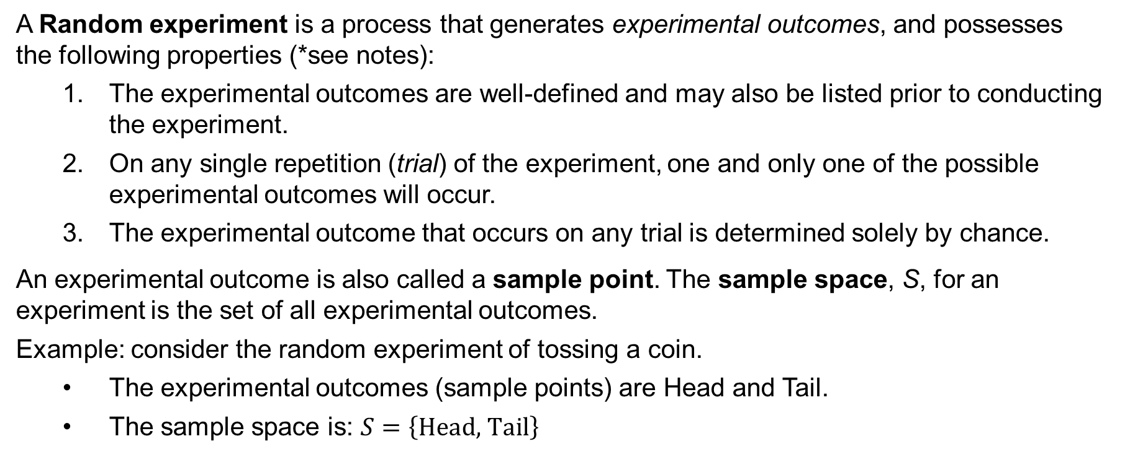
4.1 Experiments, Counting Rules, and Assigning Probabilities
A Random experiment is a process that generates experimental outcomes, and possesses the following properties (*see notes):
The experimental outcomes are well-defined and may also be listed prior to conducting the experiment.
On any single repetition (trial) of the experiment, one and only one of the possible experimental outcomes will occur.
The experimental outcome that occurs on any trial is determined solely by chance.
An experimental outcome is also called a sample point. The sample space, S, for an experiment is the set of all experimental outcomes.
Example: consider the random experiment of tossing a coin.
The experimental outcomes (sample points) are Head and Tail.
The sample space is: $S=\left\{\text{Head}\text{, }\text{Tail}\right\}$
Notes:
*Note: in statistics, the notion of an experiment differs somewhat from the notion of an experiment in the physical sciences. In the physical sciences, researchers usually conduct an experiment in a laboratory or a controlled environment in order to learn about cause and effect. In statistical experiments, probability determines outcomes. Even though the experiment is repeated in exactly the same way, an entirely different outcome may occur. Because of this influence of probability on the outcome, the experiments of statistics are sometimes called random experiments.

Slide 6
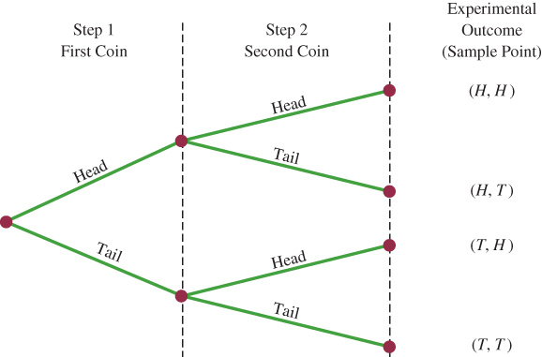
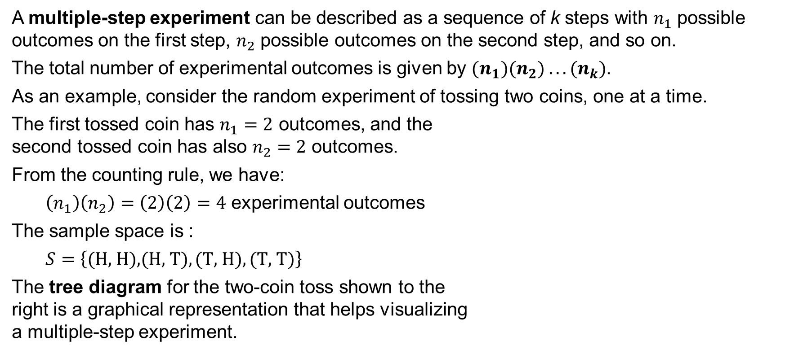
4.1 Counting Rule for Multiple-Step Experiments
A multiple-step experiment can be described as a sequence of k steps with $n_{1}$ possible outcomes on the first step, $n_{2}$ possible outcomes on the second step, and so on.
The total number of experimental outcomes is given by $(n_{1})(n_{2}) . . . (n_{k})$.
As an example, consider the random experiment of tossing two coins, one at a time.
The first tossed coin has $n_{1}=2$ outcomes, and the
second tossed coin has also $n_{2}=2$ outcomes.
From the counting rule, we have:
$\left(n_{1}\right)\left(n_{2}\right)=\left(2\right)\left(2\right)=4$ experimental outcomes
The sample space is :
$$S=\left\{\text{(}\text{H}\text{, }\text{H}\text{)}\text{,}\text{(}\text{H}\text{, }\text{T}\text{)},\text{(}\text{T}\text{, }\text{H}\text{)},\text{(}\text{T}\text{, }\text{T}\text{)}\right\}$$
The tree diagram for the two-coin toss shown to the
right is a graphical representation that helps visualizing
a multiple-step experiment.

Slide 7
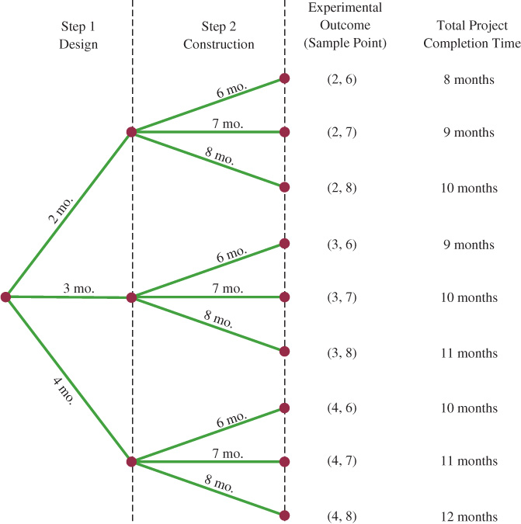
4.1 The KP&L Project: a Multiple-Step Experiment
The KP&L capacity expansion project consists of two sequential stages: design and construction.
Management expects the design stage to last 2, 3, or 4 months, the construction stage 6, 7, or 8 months, with an overall completion goal of 10 months.
Application of the counting rule for multiple-step experiments reveals a total of (3)(3) = 9 experimental outcomes.
The tree diagram to the right shows how the 9 outcomes (sample points) occur and the project completion time for each outcome.
We need to assign probabilities to each of the 9 outcomes before we can compute the probability that the project is completed on time.

Slide 8
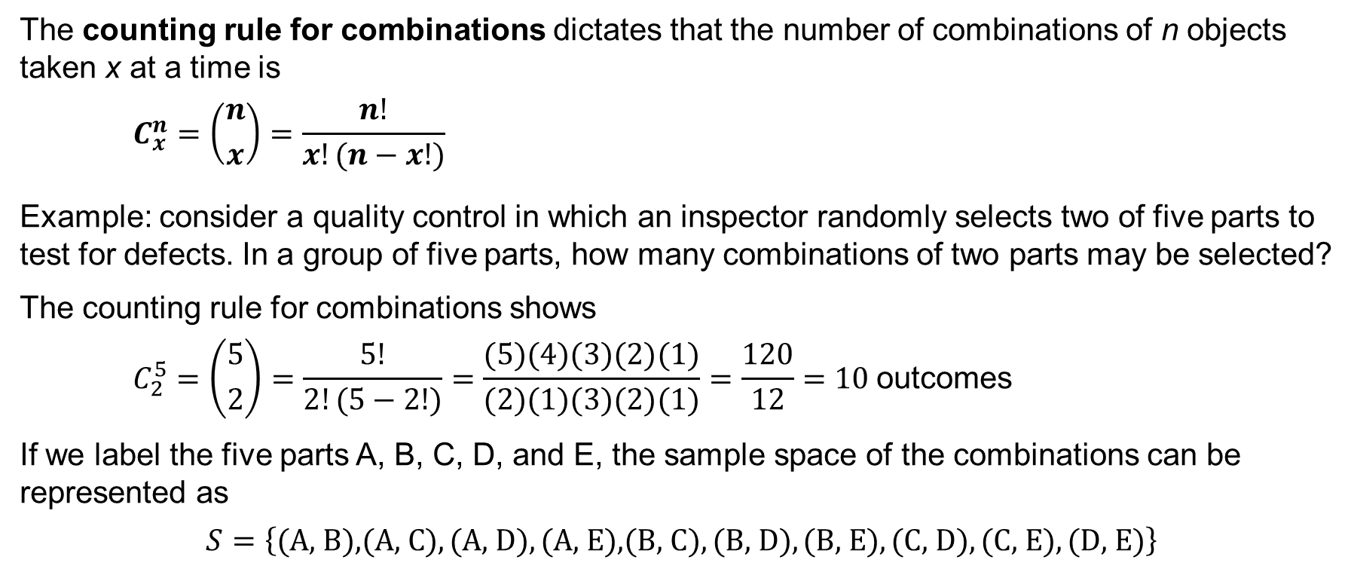
4.1 Counting Rule for Combinations
The counting rule for combinations dictates that the number of combinations of n objects taken x at a time is
$$C_{x}^{n}=\left({n \atop x}\right)=\frac{n!}{x!(n−x!)}$$
Example: consider a quality control in which an inspector randomly selects two of five parts to test for defects. In a group of five parts, how many combinations of two parts may be selected?
The counting rule for combinations shows
$$C_{2}^{5}=\left({5 \atop 2}\right)=\frac{5!}{2!(5−2!)}=\frac{(5)(4)(3)(2)(1)}{(2)(1)(3)(2)(1)}=\frac{120}{12}=10 \text{outcomes}$$
If we label the five parts A, B, C, D, and E, the sample space of the combinations can be represented as
$$S=\left\{\text{(}\text{A}\text{, }\text{B}\text{)}\text{,}\text{(}\text{A}\text{, }\text{C}\text{)},\text{(}\text{A}\text{, }\text{D}\text{)},\text{(}\text{A}\text{, }\text{E}\text{),(}\text{B}\text{, }\text{C}\text{)},\text{(}\text{B}\text{, }\text{D}\text{)},\text{(}\text{B}\text{, }\text{E}\text{)},\text{(}\text{C}\text{, }\text{D}\text{)},\text{(}\text{C}\text{, }\text{E}\text{)},\text{(}\text{D}\text{, }\text{E}\text{)}\right\}$$

Slide 9
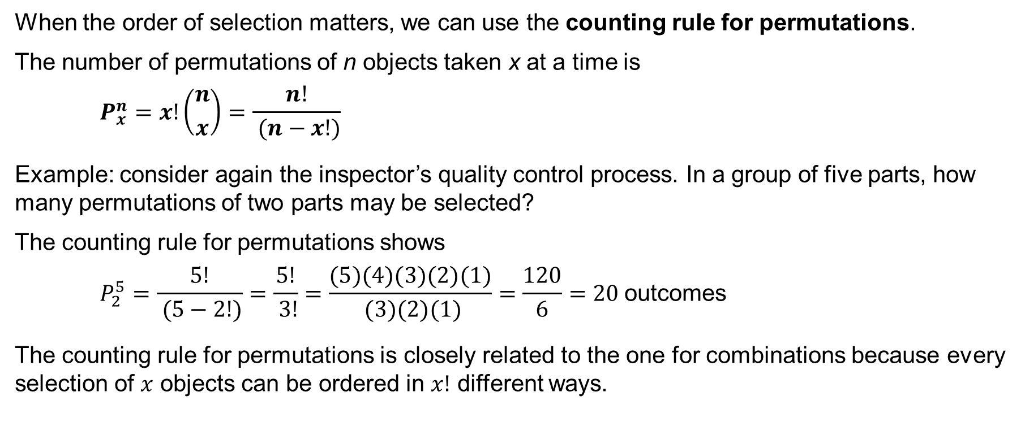
4.1 Counting Rule for Permutations
When the order of selection matters, we can use the counting rule for permutations.
The number of permutations of n objects taken x at a time is
$$P_{x}^{n}=x!\left({n \atop x}\right)=\frac{n!}{ (n−x!)}$$
Example: consider again the inspector’s quality control process. In a group of five parts, how many permutations of two parts may be selected?
The counting rule for permutations shows
$$P_{2}^{5}=\frac{5!}{ (5−2!)}=\frac{5!}{ 3!}=\frac{(5)(4)(3)(2)(1)}{ (3)(2)(1)}=\frac{120}{6}=20 \text{outcomes}$$
The counting rule for permutations is closely related to the one for combinations because every selection of $x$ objects can be ordered in $x!$ different ways.

Slide 10
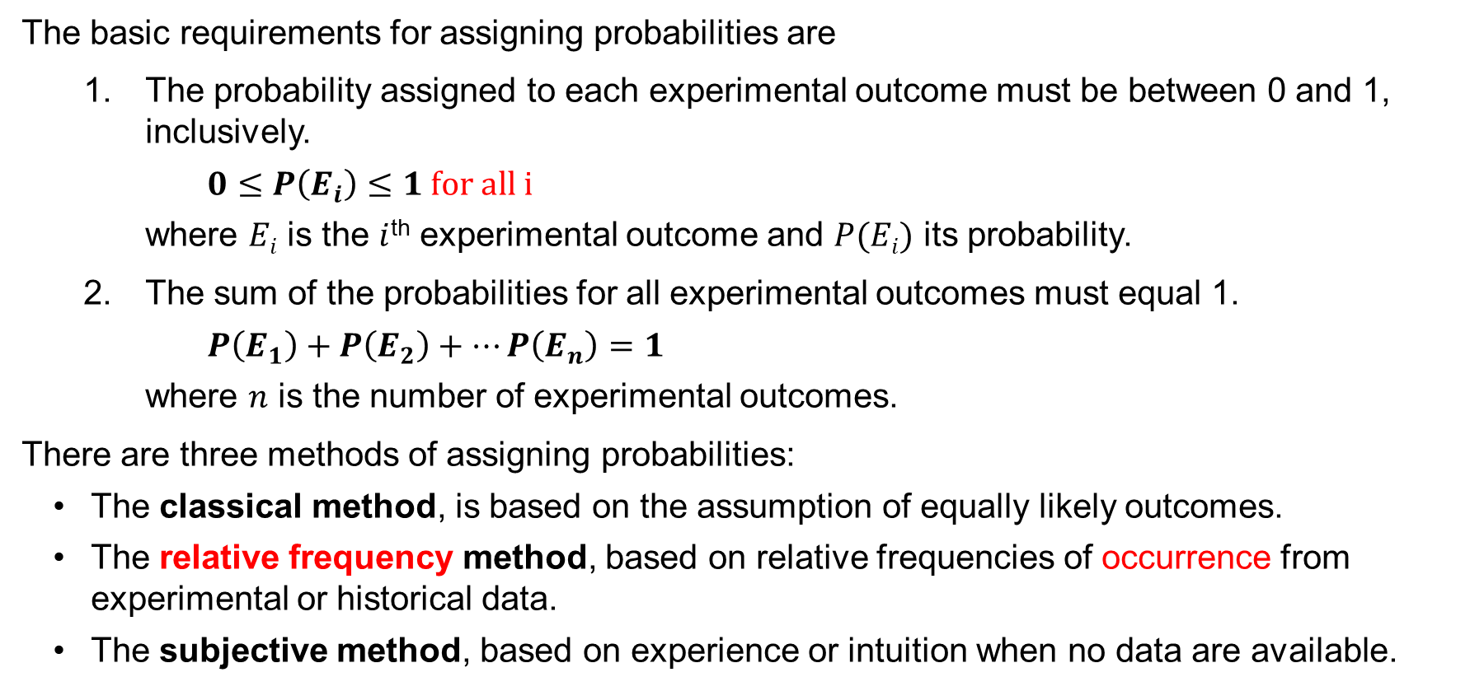
4.1 Assigning Probabilities
The basic requirements for assigning probabilities are
The probability assigned to each experimental outcome must be between 0 and 1, inclusively.
$$0≤P\left(E_{i}\right)≤1 for all i$$
where $Ei$ is the $i$^{th} experimental outcome and $P(Ei)$ its probability.
The sum of the probabilities for all experimental outcomes must equal 1.
$$P\left(E_{1}\right)+P\left(E_{2}\right)+…P\left(E_{n}\right)=1$$
where $n$ is the number of experimental outcomes.
There are three methods of assigning probabilities:
The classical method, is based on the assumption of equally likely outcomes.
The relative frequency method, based on relative frequencies of occurrence from experimental or historical data.
The subjective method, based on experience or intuition when no data are available.

Slide 11
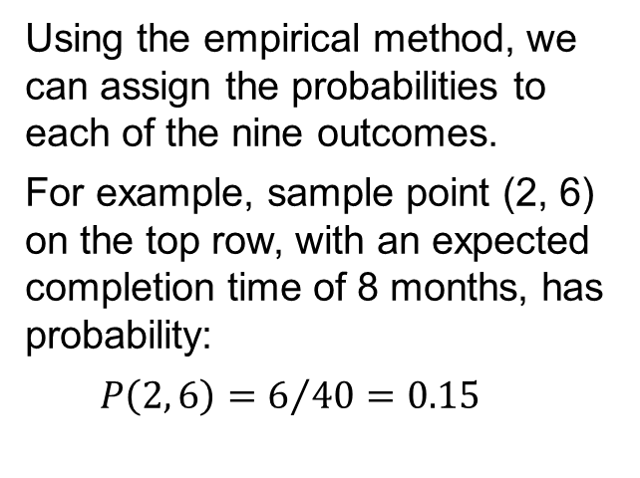
4.1 Assigning Probabilities for the KP&L Project
Using experience and judgment, KP&L management concluded that not all the outcomes were equally likely. Thus, the classical method could not be used.
A study on the completion times of 40 similar projects undertaken over the past three years revealed the frequency distribution shown.
Using the empirical method, we can assign the probabilities to each of the nine outcomes.
For example, sample point (2, 6) on the top row, with an expected completion time of 8 months, has probability:
$$P\left(2, 6\right)=6/{40}=0.15$$
Completion Time (months)
Stage 1 Design | Stage 2 Construction | Sample Point | Project Completion Time (months) | Number of Past Projects with this completion time | Probability of Sample Point
2 | 6 | (2, 6) | 8 | 6 | P(2, 6) = 6/40 = 0.15
2 | 7 | (2, 7) | 9 | 6 | P(2, 7) = 6/40 = 0.15
2 | 8 | (2, 8) | 10 | 2 | P(2, 8) = 2/40 = 0.05
3 | 6 | (3, 6) | 9 | 4 | P(3, 6) = 4/40 = 0.10
3 | 7 | (3, 7) | 10 | 8 | P(3, 7) = 8/40 = 0.20
3 | 8 | (3, 8) | 11 | 2 | P(3, 8) = 2/40 = 0.05
4 | 6 | (4, 6) | 10 | 2 | P(4, 6) = 2/40 = 0.05
4 | 7 | (4, 7) | 11 | 4 | P(4, 7) = 4/40 = 0.10
4 | 8 | (4, 8) | 12 | 6 | P(4, 8) = 6/40 = 0.15
 |  |  |  | Total = 40 | Total = 1.00

Slide 12
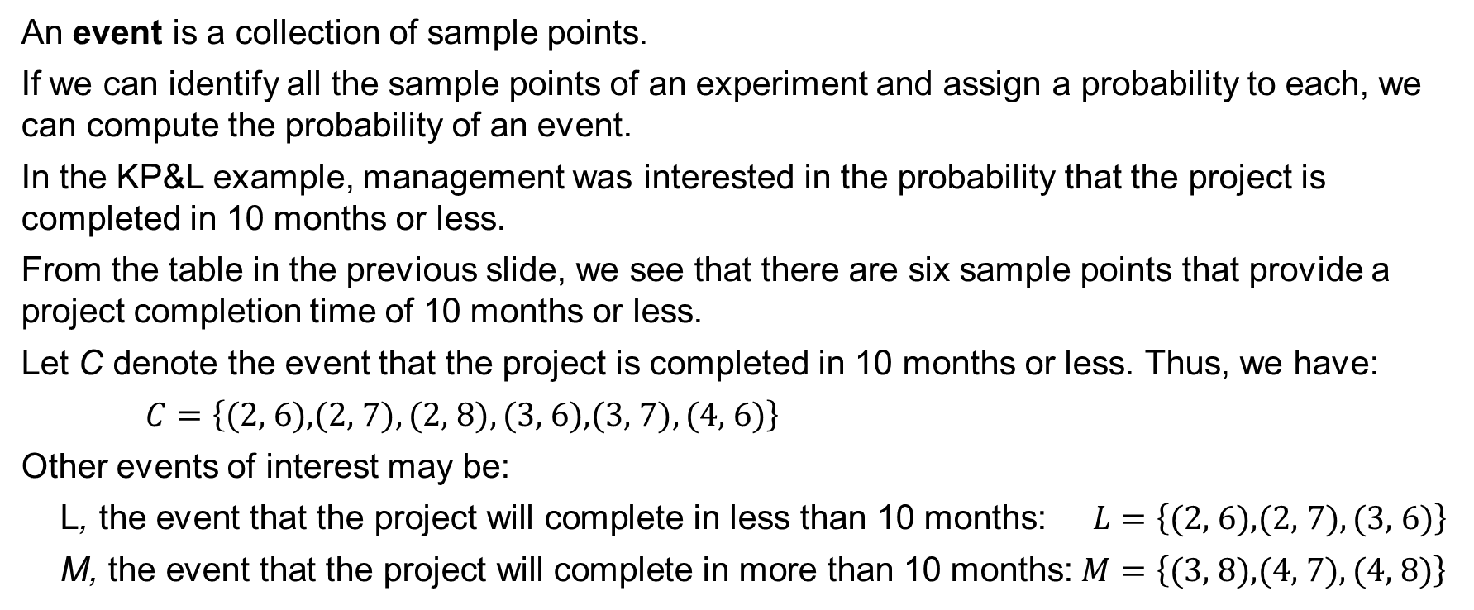
4.2 Events and Their Probabilities
An event is a collection of sample points.
If we can identify all the sample points of an experiment and assign a probability to each, we can compute the probability of an event.
In the KP&L example, management was interested in the probability that the project is completed in 10 months or less.
From the table in the previous slide, we see that there are six sample points that provide a project completion time of 10 months or less.
Let C denote the event that the project is completed in 10 months or less. Thus, we have:
$$C=\left\{\text{(}\text{2}\text{,}\text{ 6}\text{)}\text{,}\text{(}\text{2}\text{,}\text{ 7}\text{)},\text{(}\text{2}\text{,}\text{ 8}\text{)},\text{(}\text{3}\text{,}\text{ 6}\text{),(}\text{3}\text{,}\text{ 7}\text{)},\text{(}\text{4}\text{,}\text{ 6}\text{)}\right\}$$
Other events of interest may be:
L, the event that the project will complete in less than 10 months: $L=\left\{\text{(}\text{2}\text{,}\text{ 6}\text{),(}\text{2}\text{,} \text{7)},\text{(}\text{3}\text{,}\text{ 6}\text{)}\right\}$
M, the event that the project will complete in more than 10 months: $M=\left\{\text{(}\text{3}\text{,}\text{ 8}\text{)}\text{,}\text{(}\text{4}\text{,}\text{ 7}\text{)},\text{(}\text{4}\text{,}\text{ 8}\text{)}\right\}$

Slide 13
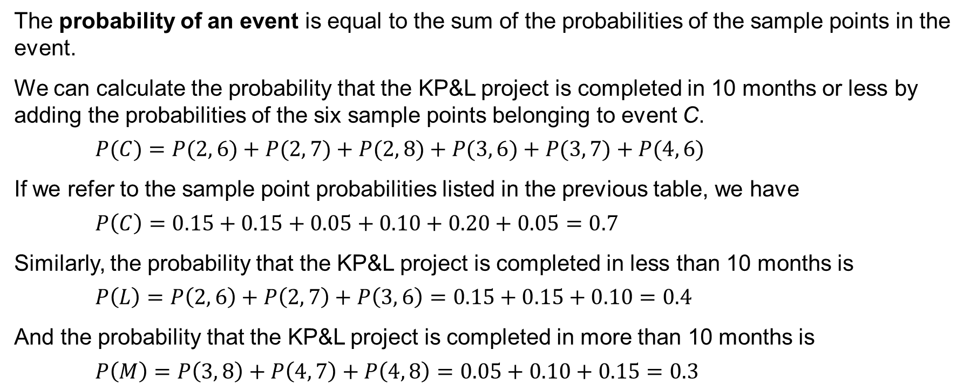
4.2 Probability of an Event
The probability of an event is equal to the sum of the probabilities of the sample points in the event.
We can calculate the probability that the KP&L project is completed in 10 months or less by adding the probabilities of the six sample points belonging to event C.
$$P(C)=P(2, 6)+P(2, 7)+P(2, 8)+P(3, 6)+P(3, 7)+P(4, 6)$$
If we refer to the sample point probabilities listed in the previous table, we have
$$P\left(C\right)=0.15+0.15+0.05+0.10+0.20+0.05=0.7$$
Similarly, the probability that the KP&L project is completed in less than 10 months is
$$P\left(L\right)=P\left(2, 6\right)+P\left(2, 7\right)+P\left(3, 6\right)=0.15+0.15+0.10=0.4$$
And the probability that the KP&L project is completed in more than 10 months is
$$P\left(M\right)=P\left(3, 8\right)+P\left(4, 7\right)+P\left(4, 8\right)=0.05+0.10+0.15=0.3$$

Slide 14
4.3 Some Basic Relationships of Probability
In an experiment with a large number of sample points, the identification of all the sample points, as well as the determination of their associated probabilities, can become an extremely cumbersome task.
In this section, we present some basic probability relationships that can be used to compute the probability of an event without knowledge of all the sample point probabilities.
These basic relationships of probability are:
The complement of an event
The union of two events
The intersection of two events
The addition law
The multiplication law

Slide 15
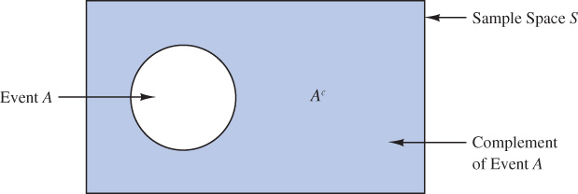
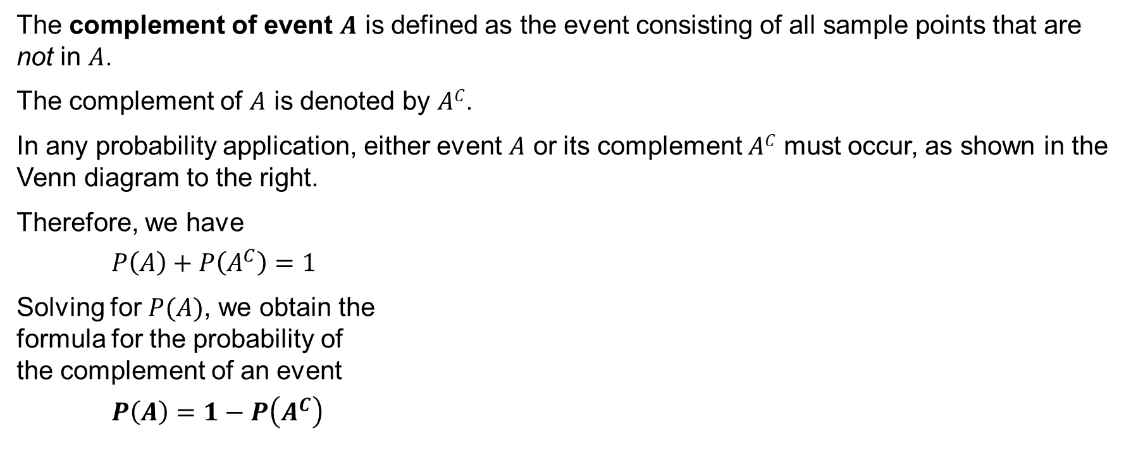
4.3 Complement of an Event
The complement of event $A$ is defined as the event consisting of all sample points that are not in $A$.
The complement of $A$ is denoted by $AC$.
In any probability application, either event $A$ or its complement $AC$ must occur, as shown in the Venn diagram to the right.
Therefore, we have
$$P\left(A\right)+P\left(A^{C}\right)=1$$
Solving for $P(A)$, we obtain the
formula for the probability of
the complement of an event
$$P\left(A\right)=1−P\left(A^{C}\right)$$

Slide 16
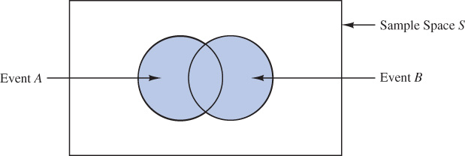
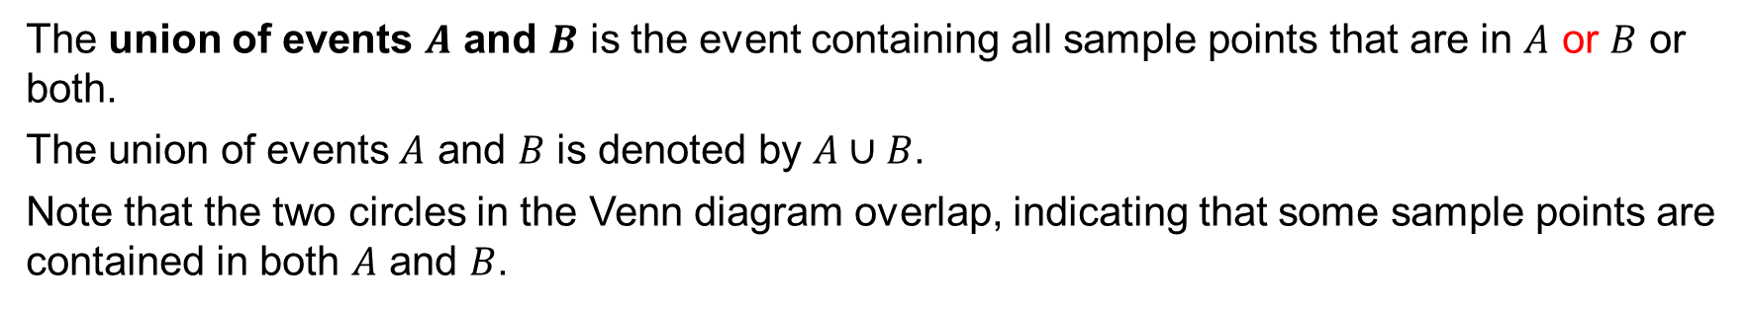
4.3 Union of Two Events
The union of events $A$ and $B$ is the event containing all sample points that are in $A$ or $B$ or both.
The union of events $A$ and $B$ is denoted by $A∪B$.
Note that the two circles in the Venn diagram overlap, indicating that some sample points are contained in both $A$ and $B$.

Slide 17
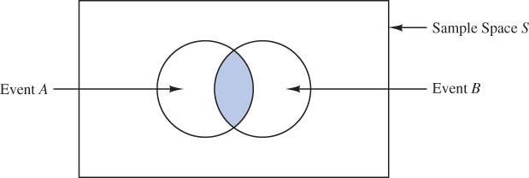
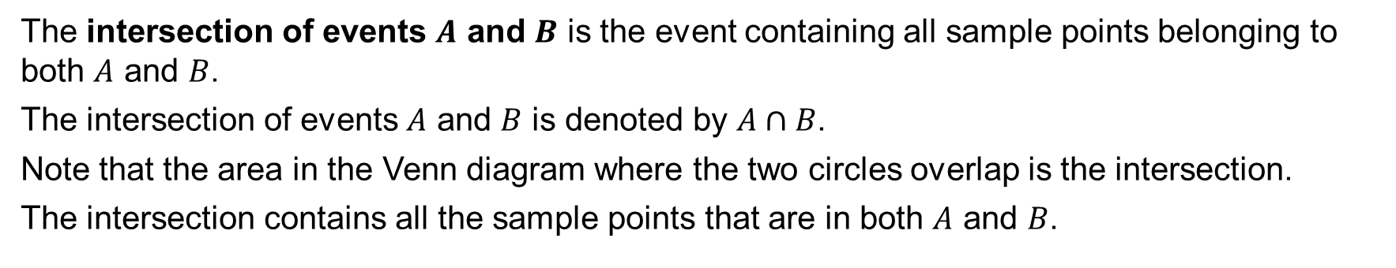
4.3 Intersection of Two Events
The intersection of events $A$ and $B$ is the event containing all sample points belonging to both $A$ and $B$.
The intersection of events $A$ and $B$ is denoted by $A∩B$.
Note that the area in the Venn diagram where the two circles overlap is the intersection.
The intersection contains all the sample points that are in both $A$ and $B$.

Slide 18
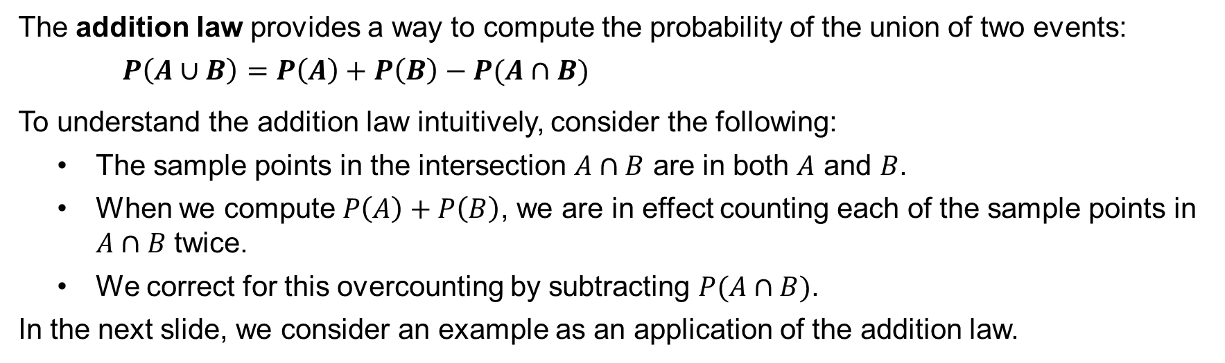
4.3 Addition Law
The addition law provides a way to compute the probability of the union of two events:
$$P\left(A∪B\right)=P\left(A\right)+P\left(B\right)−P(A∩B)$$
To understand the addition law intuitively, consider the following:
The sample points in the intersection $A∩B$ are in both $A$ and $B$.
When we compute $P\left(A\right)+P\left(B\right)$, we are in effect counting each of the sample points in $A∩B$ twice.
We correct for this overcounting by subtracting $P(A∩B)$.
In the next slide, we consider an example as an application of the addition law.

Slide 19
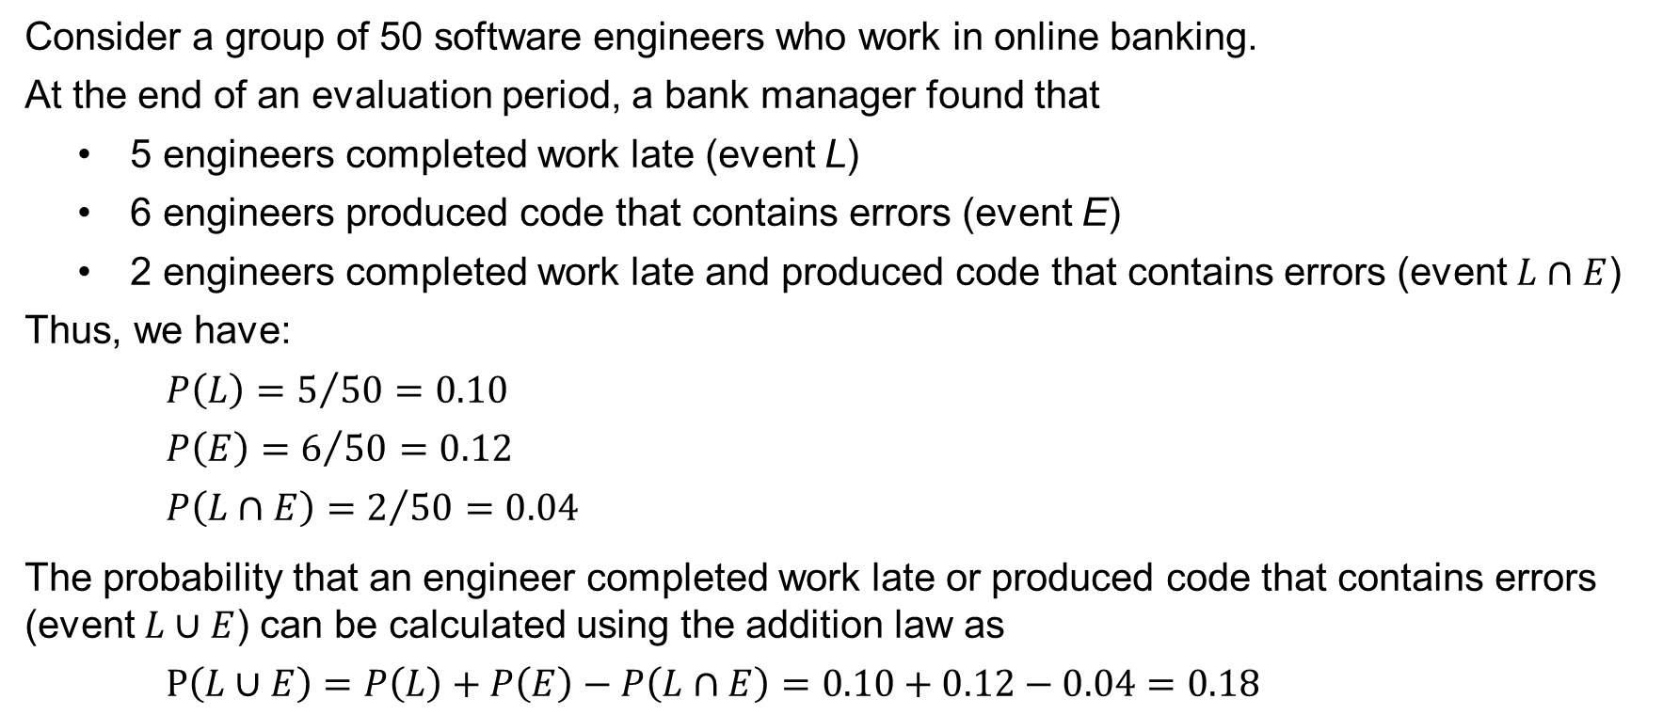
4.3 An Application of the Addition Law
Consider a group of 50 software engineers who work in online banking.
At the end of an evaluation period, a bank manager found that
5 engineers completed work late (event L)
6 engineers produced code that contains errors (event E)
2 engineers completed work late and produced code that contains errors (event $L∩E$)
Thus, we have:
$$P\left(L\right)=5/{50}=0.10$$
$$P\left(E\right)=6/{50}=0.12$$
$$P\left(L∩E\right)=2/{50}=0.04$$
The probability that an engineer completed work late or produced code that contains errors (event $L∪E$) can be calculated using the addition law as
$$P\left(L∪E\right)=P\left(L\right)+P\left(E\right)−P\left(L∩E\right)=0.10+0.12−0.04=0.18$$

Slide 20
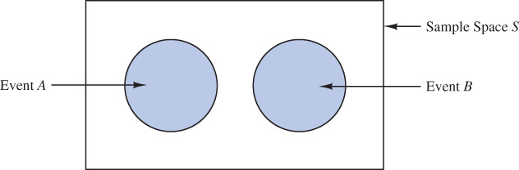
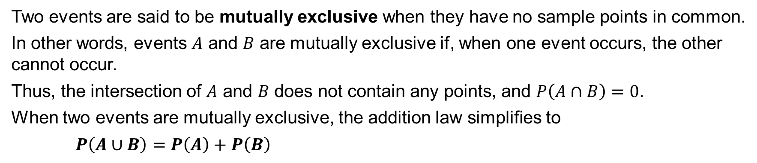
4.3 Mutually Exclusive Events
Two events are said to be mutually exclusive when they have no sample points in common.
In other words, events $A$ and $B$ are mutually exclusive if, when one event occurs, the other cannot occur.
Thus, the intersection of $A$ and $B$ does not contain any points, and $P\left(A∩B\right)=0$.
When two events are mutually exclusive, the addition law simplifies to
$$P\left(A∪B\right)=P\left(A\right)+P\left(B\right)$$

Slide 21
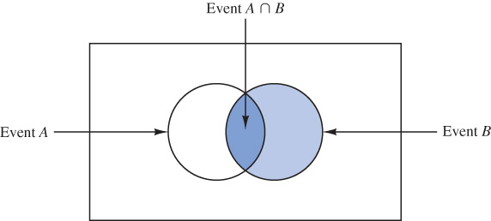
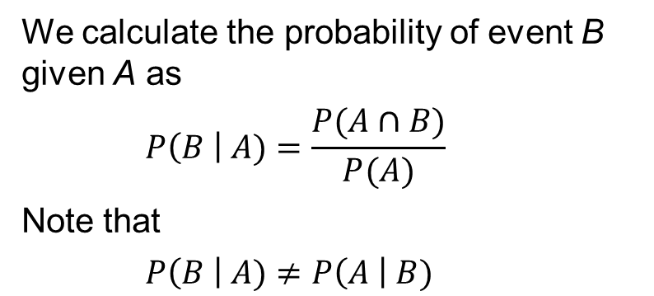
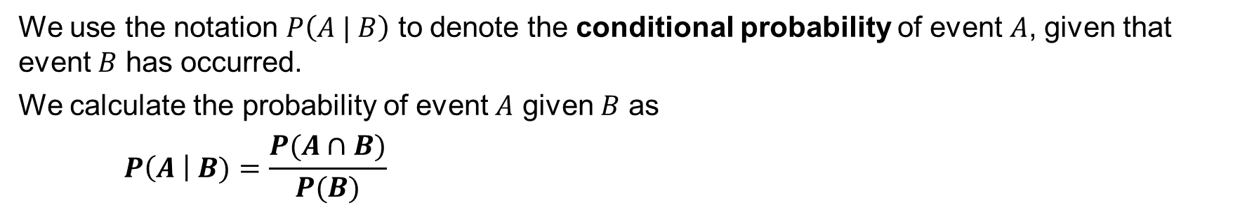
4.4 Conditional Probability
We use the notation $P\left(A | B\right)$ to denote the conditional probability of event $A$, given that event $B$ has occurred.
We calculate the probability of event $A$ given $B$ as
$$P\left(A \right| B)=\frac{P(A∩B)}{P(B)}$$
We calculate the probability of event B given A as
$$P\left(B \right| A)=\frac{P(A∩B)}{P(A)}$$
Note that
$$P\left(B \right| A)≠P\left(A \right| B)$$

Slide 22
4.4 Application: A Discrimination Case on the Promotion of Police Officers
The police force of a major metropolitan area in the eastern U.S. consists of 1200 officers, 960 self-identified males, and 240 self-identified females.
The specific breakdown of the promotions of 288 male and 36 female police officers over the past two years is summarized in the crosstabulation shown below.
After reviewing the promotion record, a committee of female officers raised a discrimination case on the basis of the low promotion of female officers when compared to male officers.
The police administration argued that the lower number of promotions for female officers was due to the relatively lower number of female officers in the police force.
 | Male | Female | Total
Promoted | 288 | 36 | 324
Not Promoted | 672 | 204 | 876
Total | 960 | 240 | 1,200

Slide 23
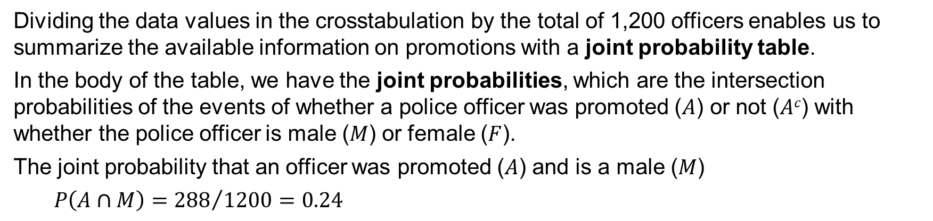
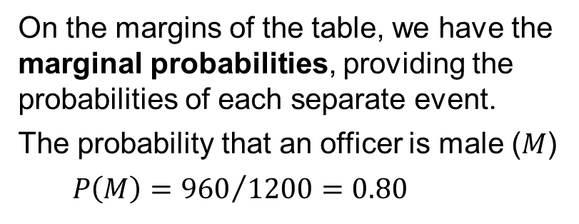
4.4 Joint Probability Table
Dividing the data values in the crosstabulation by the total of 1,200 officers enables us to summarize the available information on promotions with a joint probability table.
In the body of the table, we have the joint probabilities, which are the intersection probabilities of the events of whether a police officer was promoted ($A$) or not ($Ac$) with whether the police officer is male ($M$) or female ($F$).
The joint probability that an officer was promoted ($A$) and is a male ($M$)
$$P\left(A∩M\right)={288}/{1200}=0.24$$
 | Male (M) | Female (F) | Total
Promoted (A) | 0.24 | 0.03 | 0.27
Not Promoted (A^{c}) | 0.56 | 0.17 | 0.73
Total | 0.80 | 0.20 | 1.00
On the margins of the table, we have the marginal probabilities, providing the probabilities of each separate event.
The probability that an officer is male ($M$)
$$P\left(M\right)={960}/{1200}=0.80$$

Slide 24
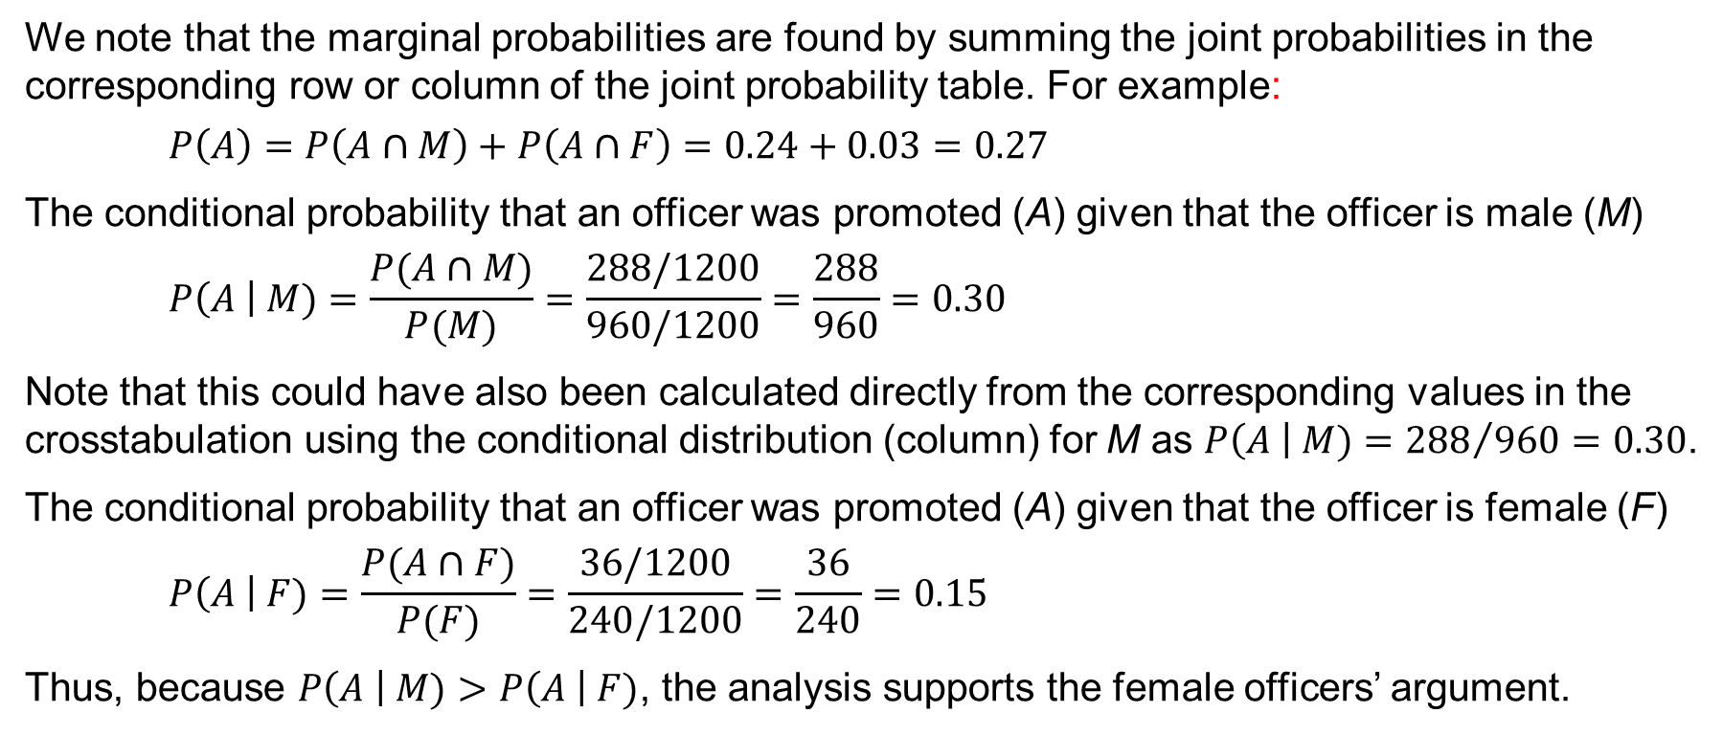
4.4 Conditional Probability Analysis
We note that the marginal probabilities are found by summing the joint probabilities in the corresponding row or column of the joint probability table. For example:
$$P\left(A\right)=P\left(A∩M\right)+P\left(A∩F\right)=0.24+0.03=0.27$$
The conditional probability that an officer was promoted (A) given that the officer is male (M)
$$P\left(A \right| M)=\frac{P(A∩M)}{P(M)}=\frac{288/1200}{960/1200}=\frac{288}{960}=0.30$$
Note that this could have also been calculated directly from the corresponding values in the crosstabulation using the conditional distribution (column) for M as $P\left(A \right| M)={288}/{960}=0.30$.
The conditional probability that an officer was promoted (A) given that the officer is female (F)
$$P\left(A \right| F)=\frac{P(A∩F)}{P(F)}=\frac{36/1200}{240/1200}=\frac{36}{240}=0.15$$
Thus, because $P\left(A \right| M)>P\left(A \right| F)$, the analysis supports the female officers’ argument.

Slide 25
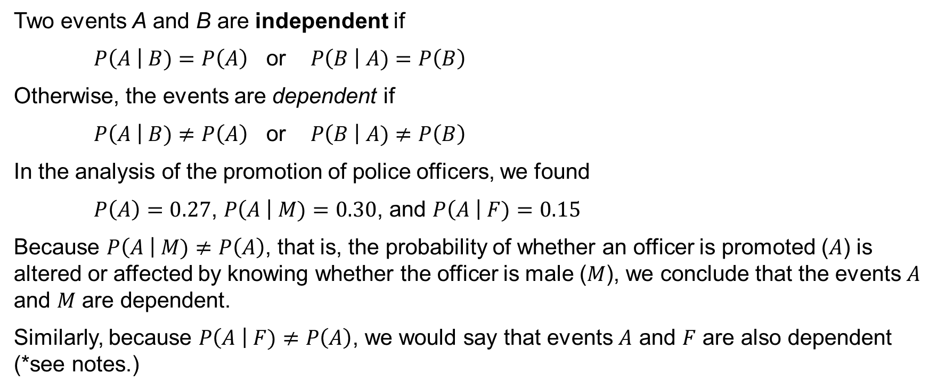
4.4 Independent Events
Two events A and B are independent if
$P\left(A \right| B)=P\left(A\right)$ or $P\left(B \right| A)=P\left(B\right)$
Otherwise, the events are dependent if
$P\left(A \right| B)≠P\left(A\right)$ or $P\left(B \right| A)≠P\left(B\right)$
In the analysis of the promotion of police officers, we found
$P\left(A\right)=0.27$, $P\left(A \right| M)=0.30$, and $P\left(A \right| F)=0.15$
Because $P\left(A \right| M)≠P\left(A\right)$, that is, the probability of whether an officer is promoted ($A$) is altered or affected by knowing whether the officer is male ($M$), we conclude that the events $A$ and $M$ are dependent.
Similarly, because $P\left(A \right| F)≠P\left(A\right)$, we would say that events $A$ and $F$ are also dependent (*see notes.)
Notes:
*Note: Do not confuse the notion of mutually exclusive events with that of independent events. Two events with nonzero probabilities cannot be both mutually exclusive and independent. If one mutually exclusive event is known to occur, the other cannot occur. Thus, the probability of the other event occurring is reduced to 0. Therefore, the two events are dependent.

Slide 26
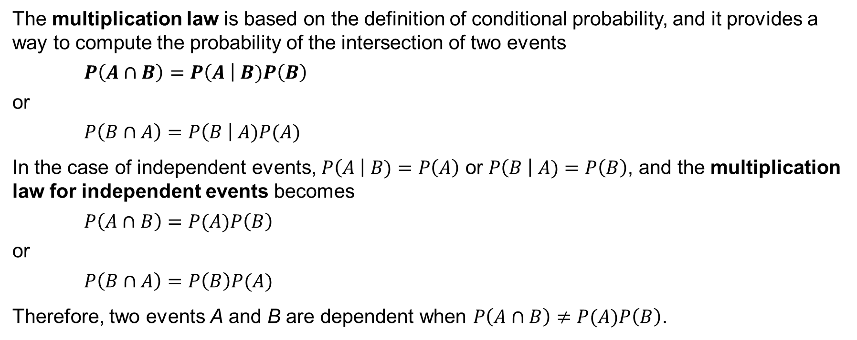
4.4 Multiplication Law
The multiplication law is based on the definition of conditional probability, and it provides a way to compute the probability of the intersection of two events
$$P\left(A∩B\right)=P\left(A \right| B)P\left(B\right)$$
or
$$P\left(B∩A\right)=P\left(B \right| A)P(A)$$
In the case of independent events, $P\left(A \right| B)=P\left(A\right)$ or $P\left(B \right| A)=P\left(B\right)$, and the multiplication law for independent events becomes
$$P\left(A∩B\right)=P(A)P\left(B\right)$$
or
$$P\left(B∩A\right)=P\left(B\right)P(A)$$
Therefore, two events A and B are dependent when $P\left(A∩B\right)≠P(A)P\left(B\right)$.

Slide 27

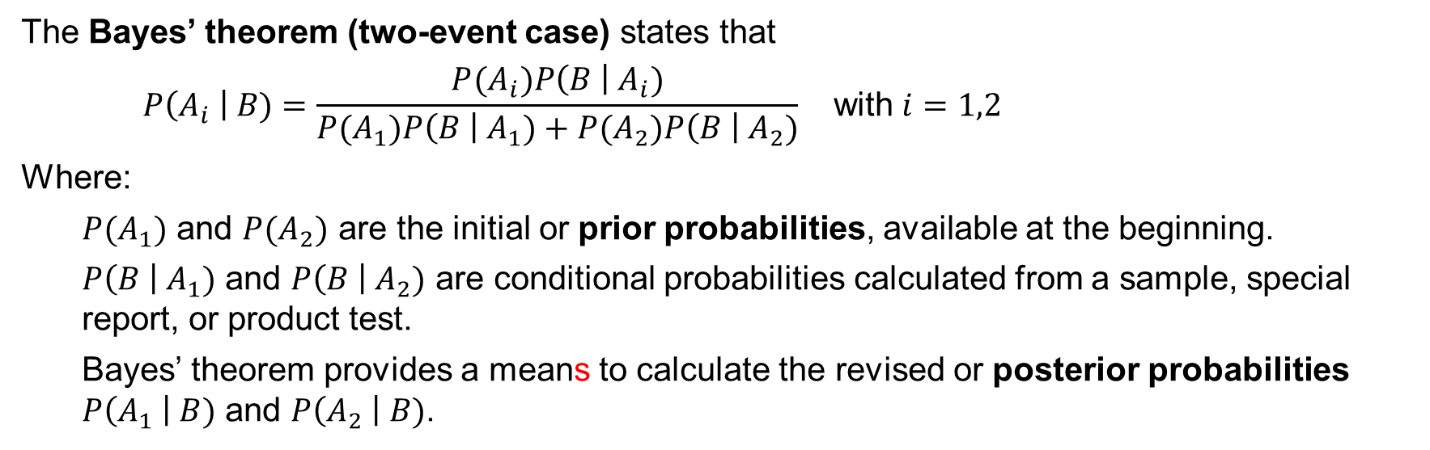
4.5 Bayes’ Theorem
The Bayes’ theorem (two-event case) states that
$$P\left(A_{i} \right| B)=\frac{P(A_{i})P\left(B \right|{ A}_{i})}{P(A_{1})P\left(B \right|{ A}_{1})+P(A_{2})P\left(B \right|{ A}_{2})} \text{with} i=1,2$$
Where:
$P(A_{1})$ and $P(A_{2})$ are the initial or prior probabilities, available at the beginning.
$P\left(B \right|{ A}_{1})$ and $P\left(B \right|{ A}_{2})$ are conditional probabilities calculated from a sample, special report, or product test.
Bayes’ theorem provides a means to calculate the revised or posterior probabilities $P\left(A_{1} \right| B)$ and $P\left(A_{2} \right| B)$.

Slide 28
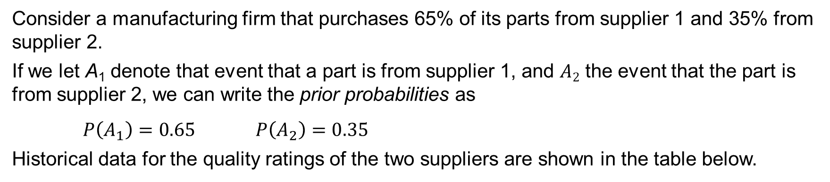
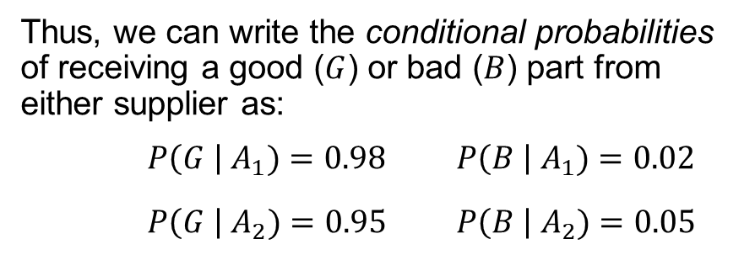
4.5 An Application of Bayes’ Theorem
Consider a manufacturing firm that purchases 65% of its parts from supplier 1 and 35% from supplier 2.
If we let A₁ denote that event that a part is from supplier 1, and $A2$ the event that the part is from supplier 2, we can write the prior probabilities as
$P\left(A_{1}\right)=0.65$ $P\left(A_{2}\right)=0.35$
Historical data for the quality ratings of the two suppliers are shown in the table below.
Thus, we can write the conditional probabilities
of receiving a good ($G$) or bad ($B$) part from
either supplier as:
$P\left(G \right| A_{1})=0.98$ $P\left(B \right| A_{1})=0.02$
$P\left(G \right| A_{2})=0.95$ $P\left(B \right| A_{2})=0.05$
 | Percentage Good Parts | Percentage Bad Parts
Supplier 1 | 98 | 2
Supplier 2 | 95 | 5

Slide 29
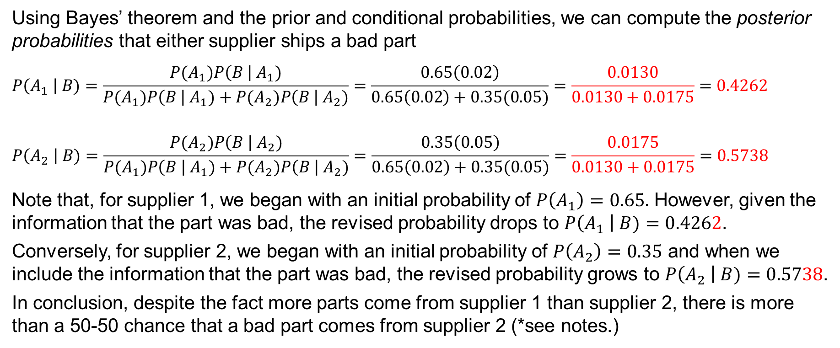
4.5 Posterior Probabilities
Using Bayes’ theorem and the prior and conditional probabilities, we can compute the posterior probabilities that either supplier ships a bad part
$$P\left(A_{1} \right| B)=\frac{P(A_{1})P\left(B \right|{ A}_{1})}{P(A_{1})P\left(B \right|{ A}_{1})+P(A_{2})P\left(B \right|{ A}_{2})}=\frac{0.65\left(0.02\right)}{0.65\left(0.02\right)+0.35(0.05)}=\frac{0.0130}{0.0130+0.0175}=0.4262$$
$$P\left(A_{2} \right| B)=\frac{P(A_{2})P\left(B \right|{ A}_{2})}{P(A_{1})P\left(B \right|{ A}_{1})+P(A_{2})P\left(B \right|{ A}_{2})}=\frac{0.35\left(0.05\right)}{0.65\left(0.02\right)+0.35(0.05)}=\frac{0.0175}{0.0130+0.0175}=0.5738$$
Note that, for supplier 1, we began with an initial probability of $P\left(A_{1}\right)=0.65.$ However, given the information that the part was bad, the revised probability drops to $P\left(A_{1} \right| B)=0.4262$.
Conversely, for supplier 2, we began with an initial probability of $P\left(A_{2}\right)=0.35$ and when we include the information that the part was bad, the revised probability grows to $P\left(A_{2} \right| B)=0.5738$.
In conclusion, despite the fact more parts come from supplier 1 than supplier 2, there is more than a 50-50 chance that a bad part comes from supplier 2 (*see notes.)
Notes:
*Note: Bayes’ theorem is used extensively in decision analysis. The prior probabilities are often subjective estimates provided by a decision-maker. Sample information is obtained and posterior probabilities are computed for use in choosing the best decision. We further explore the use of Bayes’ theorem in decision analysis in Chapter 19.

Slide 30
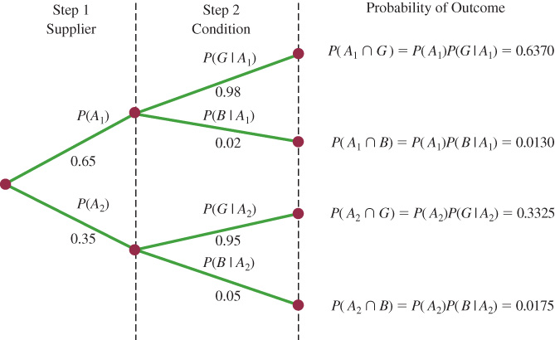

4.5 Bayes’ Theorem with a Probability Tree
Bayes’ theorem can be visualized with a
probability tree. From left to right:
Step 1 includes the two branches for the
prior probabilities of the two suppliers.
Step 2 branches out the four conditional
probabilities of receiving a good ($G$) or bad
($B$) part from either supplier 1 ($A1$) or 2 ($A2$).
The resulting four outcomes represent the
possible intersections of supplier (A₁) or (A₂)
with either a good ($G$) or bad ($B$) part.
Because $P\left(B\right)=P(A_{1}∩B)+P(A_{2}∩B)$, the
posterior probabilities in Bayes’ theorem can be calculated from the joint probabilities as
$$P\left(A_{i} \right| B)=\frac{P(A_{i}∩B)}{P(B)}=\frac{P(A_{i}∩B) }{P(A_{1}∩B)+P(A_{2}∩B)}=\frac{P(A_{i})P\left(B \right|{ A}_{i})}{P(A_{1})P\left(B \right|{ A}_{1})+P(A_{2})P\left(B \right|{ A}_{2})} \text{with} i=1,2$$

Slide 31
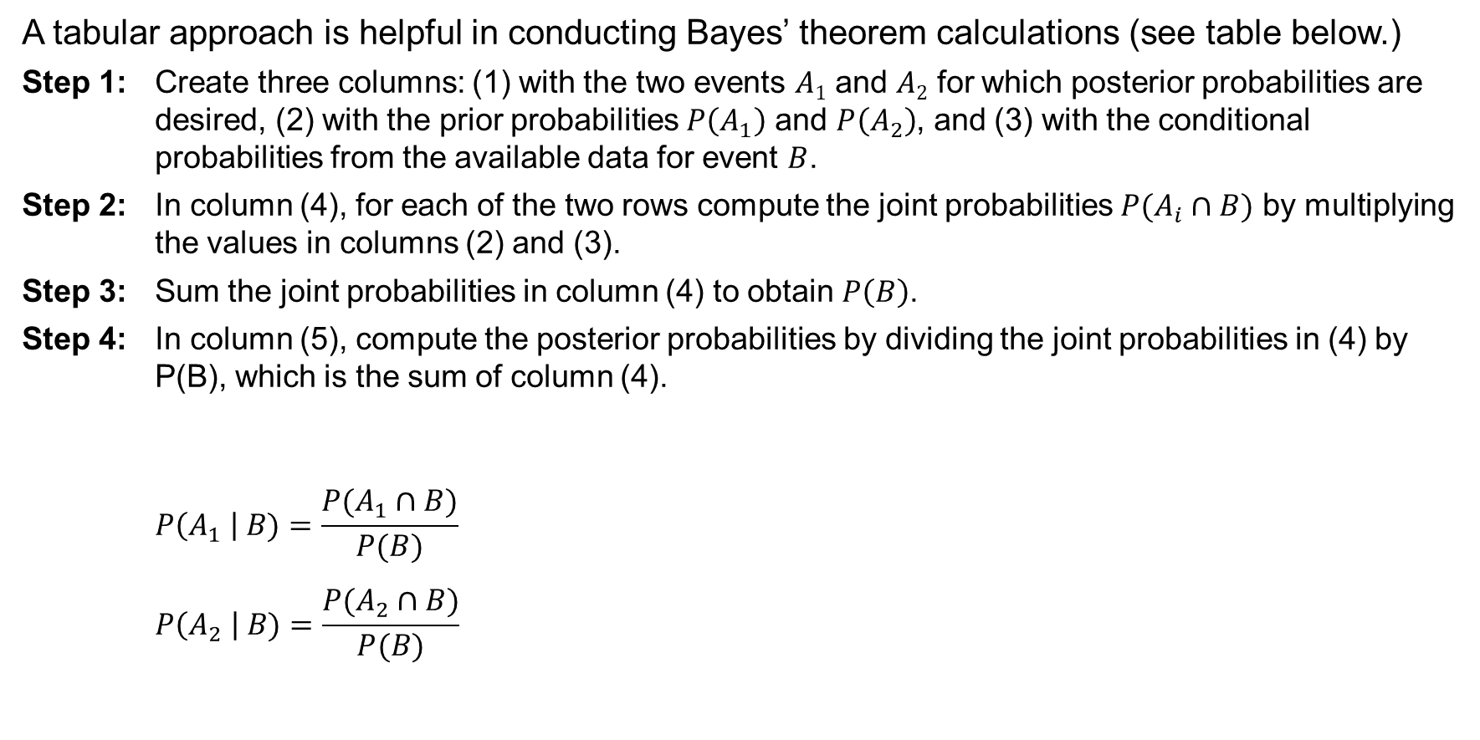
4.5 Tabular Approach to Bayes’ Theorem
A tabular approach is helpful in conducting Bayes’ theorem calculations (see table below.)
Step 1: Create three columns: (1) with the two events $A1$ and $A2$ for which posterior probabilities are desired, (2) with the prior probabilities $P\left(A_{1}\right)$ and $P\left(A_{2}\right)$, and (3) with the conditional probabilities from the available data for event $B$.
Step 2: In column (4), for each of the two rows compute the joint probabilities $P(A_{i}∩B)$ by multiplying the values in columns (2) and (3).
Step 3: Sum the joint probabilities in column (4) to obtain $P\left(B\right)$.
Step 4: In column (5), compute the posterior probabilities by dividing the joint probabilities in (4) by P(B), which is the sum of column (4).
$$P\left(A_{1} \right| B)=\frac{P(A_{1}∩B)}{P(B)}$$
$$P\left(A_{2} \right| B)=\frac{P(A_{2}∩B)}{P(B)}$$
(1) | (2) | (3) | (4) | (5)
Events | Prior Probabilities | Conditional Probabilities | Joint Probabilities | Posterior Probabilities
A_{i} | P(A_{i}) | P(B|A_{i}) | P(A_{i} ∩ B) | P(A_{i}|B)
A₁ | 0.65 | 0.02 | 0.0130 | 0.0130 / 0.0305 = 0.4262
A₂ | 0.35 | 0.05 | 0.0175 | 0.0175 / 0.0305 = 0.5738
 | 1.00 |  | 0.0305 | 1.0000

Slide 32
Summary
In this chapter, we introduced basic probability concepts and illustrated how probability analysis can be used to provide helpful information for decision-making.
We described how probability can be interpreted as a numerical measure of the likelihood that an event will occur.
In addition, we saw that the probability of an event can be computed by either:
Summing the probabilities of the experimental outcomes (sample points) that comprise the event.
Using the relationships established by different laws of probability, such as:
addition law
conditional probability
multiplication law
For cases in which additional information is available, we showed how Bayes’ theorem can be used to obtain revised or posterior probabilities.

